Slide 1
Exploratory Data Analysis

Slide 2
Exploratory vs explanatory
Exploratory
What we do to understand the data
Determine what might be noteworthy or interesting
Testing hypotheses
Explanatory
Have a specific thing to explain
Already know the insights
Smaller focus
Fewer/higher quality visualizations

Slide 3

How does it work?
Notes:
Generally static

Slide 4
Exploration Leads to Explanation
1) Some Data Set
3) Insights
2) Exploratory Analysis
5) Data Visualization
4) Explanatory Analysis and Design
This method often does not lead to actionable insights

Slide 5
How it should work
1) Context
2) Objectives
5) Data Visualization
3) Hypotheses
4) Exploratory Analysis

Slide 6
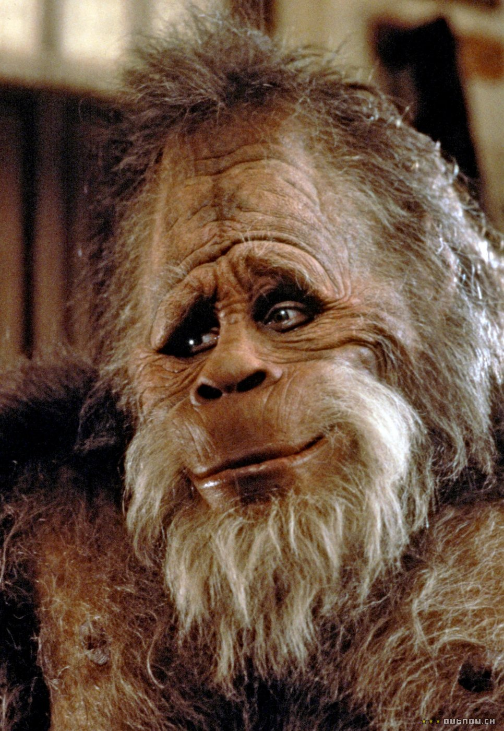
Testing hypotheses with data
Exploratory Analysis
Hypothesis: Bigfoot sightings happen more during the spring and summer when people are outside more.
Question: what data do we need?
Answer: bigfoot sightings with the season.
Question: if this is true, what would we need to see?
Answer: bar chart showing number of sightings by season. We would want to see a higher bar for spring and summer.

Slide 7
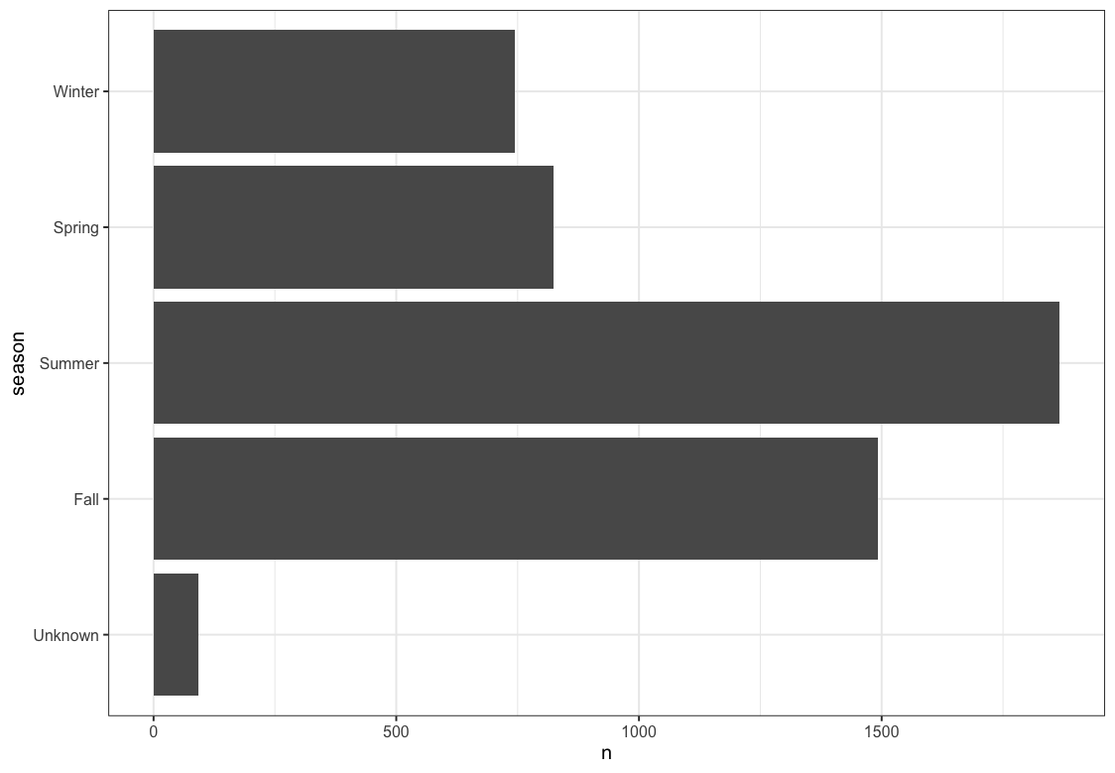
What do we see?
Bigfoot sightings are highest during the summer
Quite low in Spring, much higher in Fall than expected.
Why are sightings higher in Fall?
Do we need to understand this some more?

Slide 8
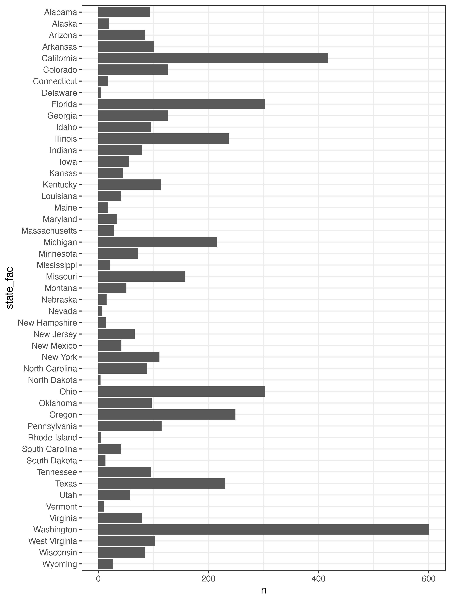
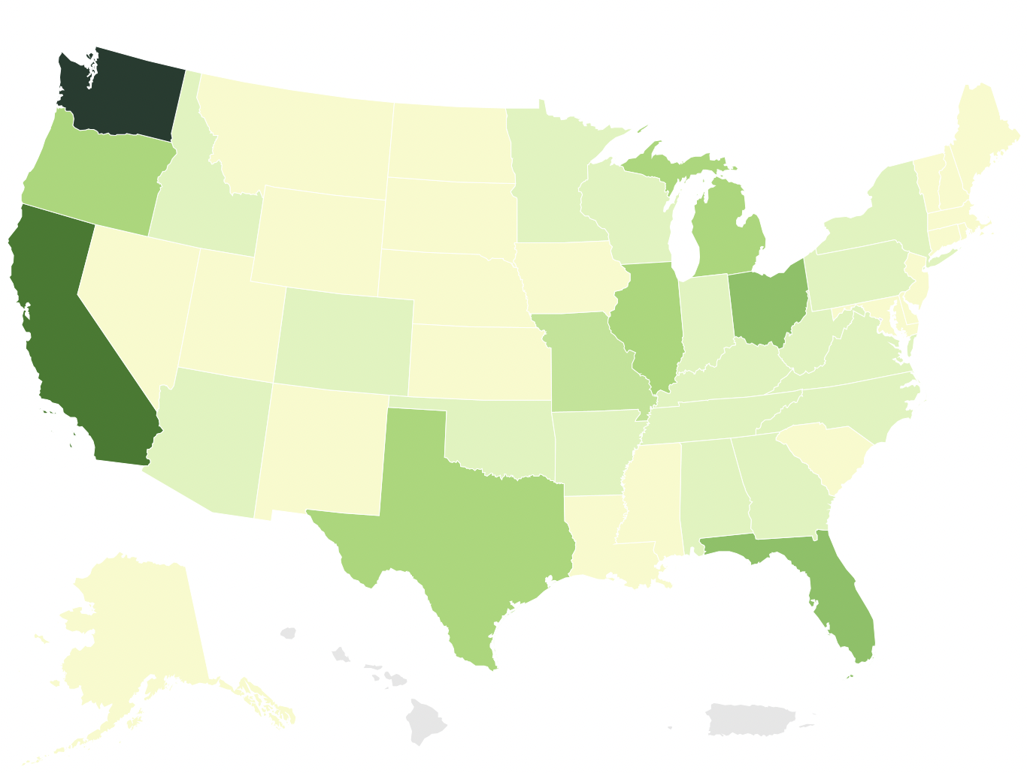
Maybe some location data would help

Slide 9
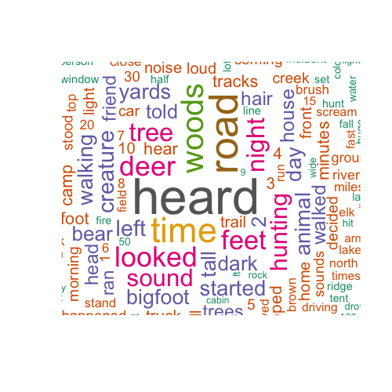
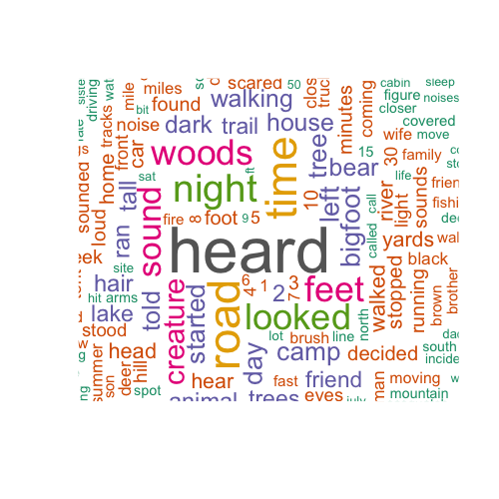
Wordcloud comparisons
How are sightings in the Fall different from sightings in the Summer?
Fall
Summer

Slide 10
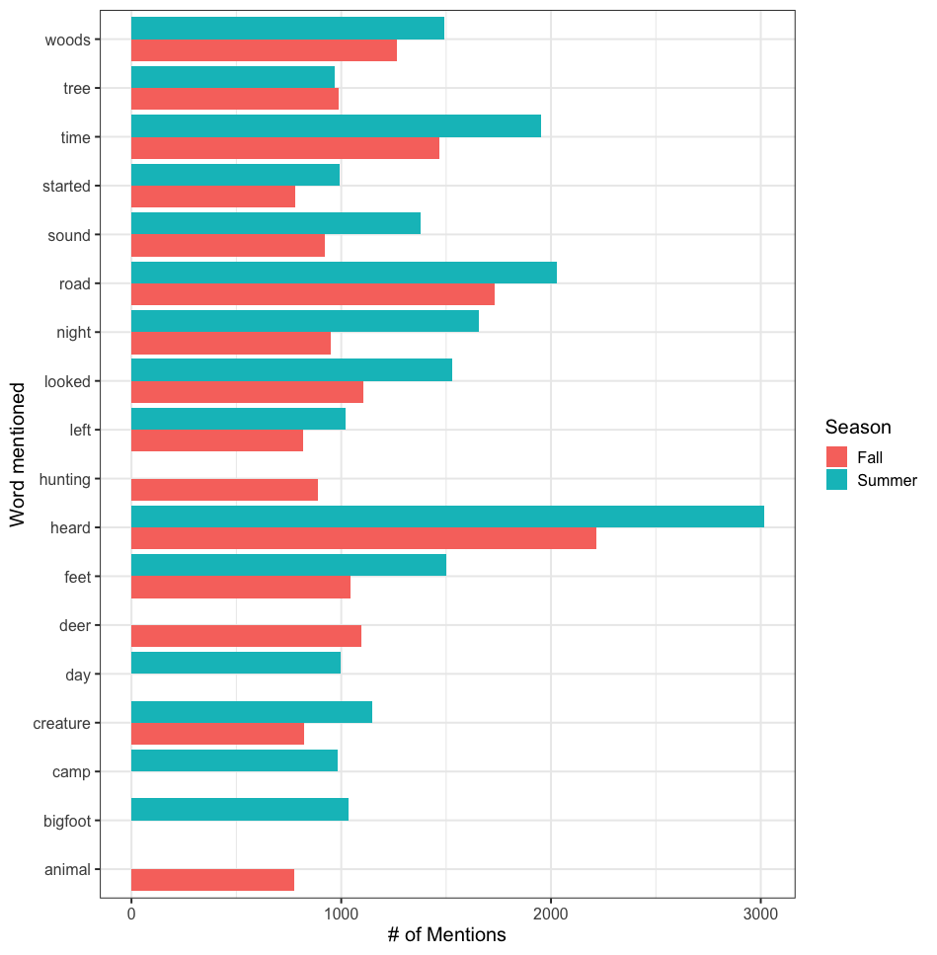
Switching to a bar chart can help
Now we can see which words show up more in one season than the other.
Is there a better way?

Slide 11
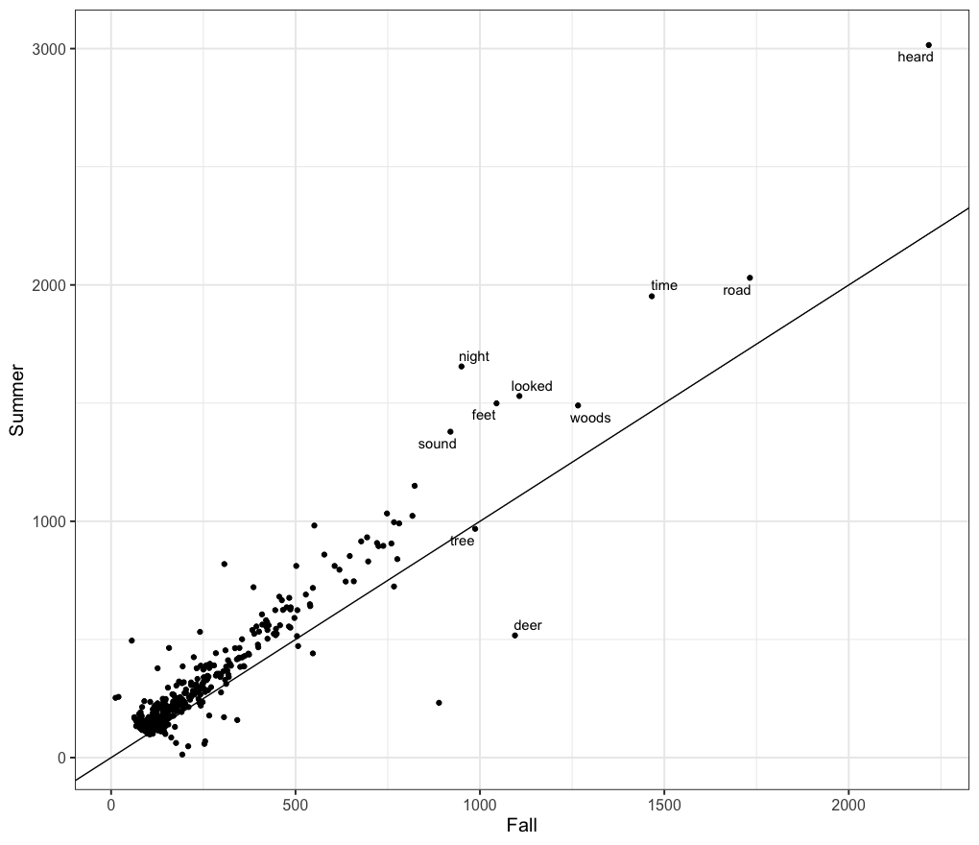
Try switching to a scatterplot
Now we have
numbers for Fall on the x-axis
Numbers for Summer on the y-axis
A line where y=x, anything above the line shows up more in the Summer, below the line shows up more in Fall
A few words labeled
What is the problem?

Slide 12
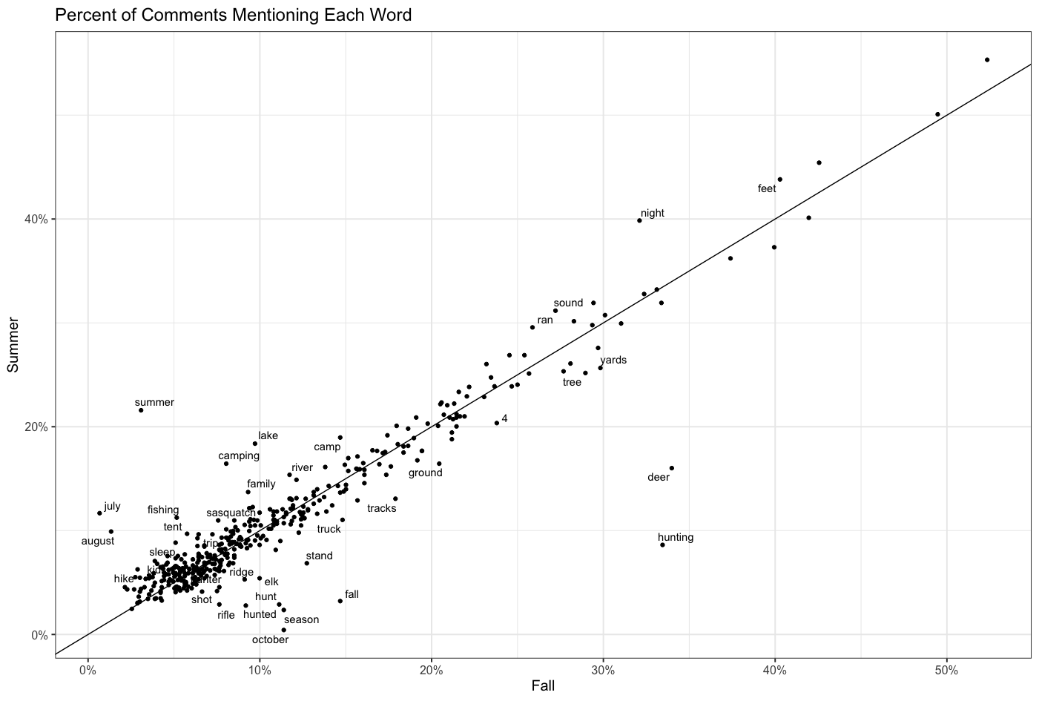
Change the variables
Now we look at the percent of sightings each word shows up in.
Interested in any large deviations.
Differences in sightings should be clear now.

Slide 13

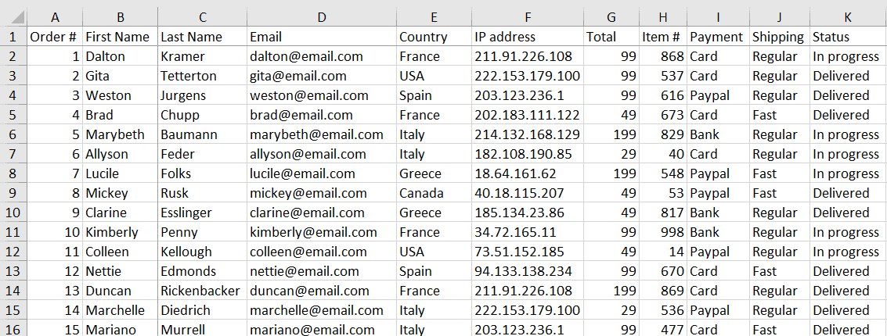

What does data look like?
Reality:
Spreadsheet is a good example.
Formatted in rows and columns
Rows represent observations or cases
Columns are the information we know about each observation
Sometimes the data isn’t stored this way in the data systems we use, but it will need to be in this format to do analysis and visualization

Slide 14
How do we get data?
Generated by the systems we use
Point of Sale
Tracking on the internet
Household appliances (IoT)
Key cards when you enter a building
Entered by people
Accounting systems
CRM
Custom apps at work
Surveys
In all cases, data acquisition is designed by people.
Make sure you are aware of the business objectives when you design the data you collect.
Many data projects end when we realize the right data wasn’t collected at the right time.

Slide 15
Common issues working with data
Transferring data between systems
Extracting data from a system and joining it to data from another can be difficult or impossible.
Process of creating different between tools
Data visualization tools often designed to solve slightly different issues. Consequently, there is often a learning curve when moving between tools.
Data accuracy
Data might not be in the right format for calculating the desired metric and you might need to manipulate the data.
Need to have some math skills to understand how things are calculated.

Slide 16
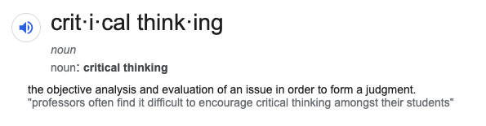
Critical thinking
Grit – don’t give up
Creativity – generate ideas and hypotheses and determine how to test them
Ask for help – set a timer and try things. If the timer runs out before you get a solution: ask me for help, ask your TA for help
Questioning assumptions
Reasoned judgements
Understanding sources of bias
Eliminating sources of bias

Slide 17
Ethics in visualization and analysis
Don’t mislead your audience
Ways charts can mislead:
Being poorly designed
Displaying dubious data
Displaying insufficient data
Concealing or confusing uncertainty
Suggesting misleading patterns
All covered in “How Charts Lie”
We’ll have lectures covering these topics later in the semester.
Privacy & Data Stewardship
Privacy – the right data shared with the right people at the right time. Also, data is not shared with the wrong people (ever).
Data Steward – someone who makes sure the right data is used for the right purpose.
Data leakage can be a big issue with big consequences for you and your organization. Make sure you send only the data someone needs. Never send data via email if you can help it.

Slide 18


